Slide 1
Leonardo da Vinci Sketches
1452-1519

Slide 2
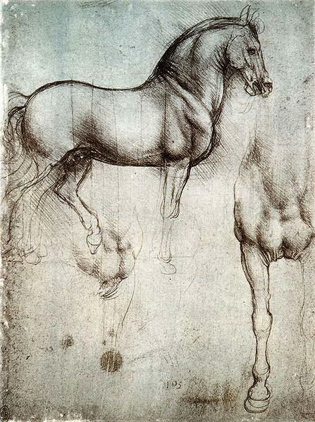
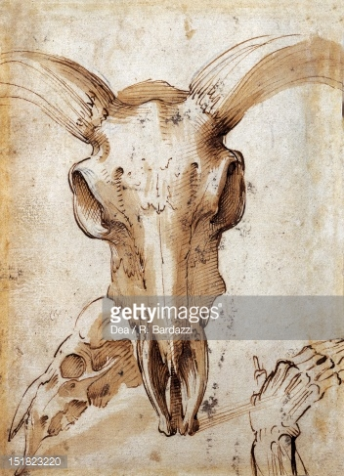

Slide 3
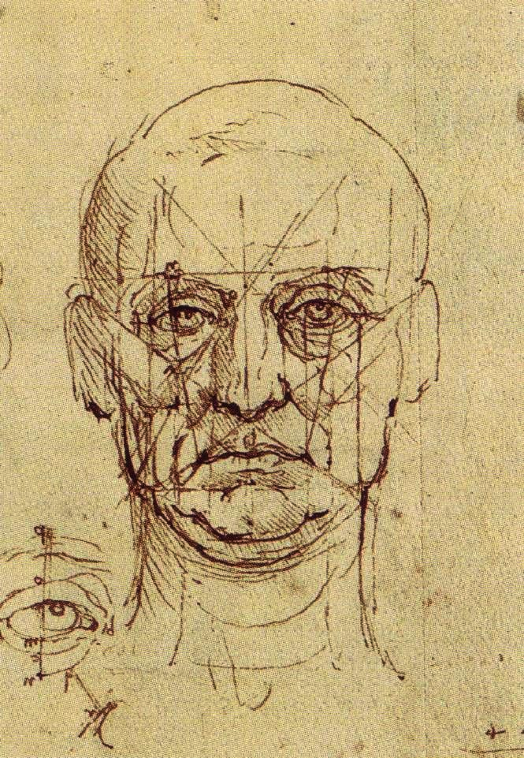
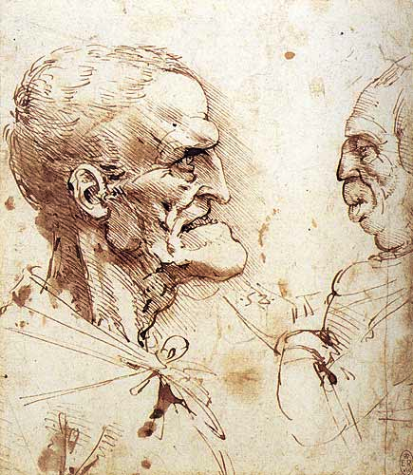

Slide 4
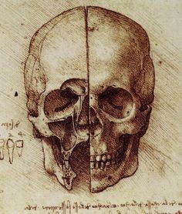
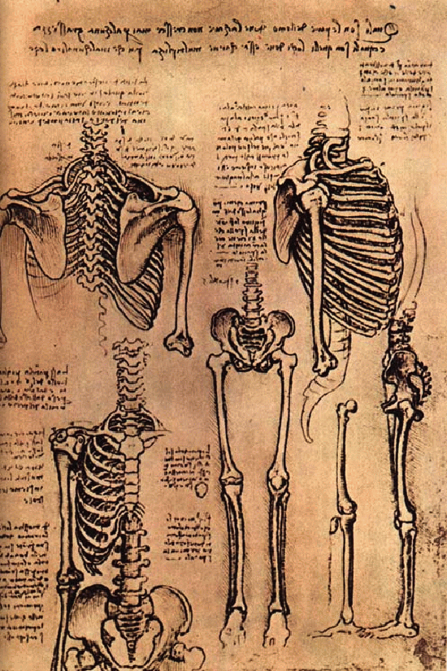

Slide 5
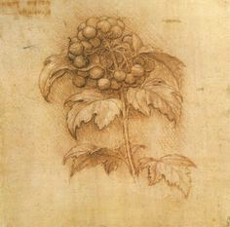
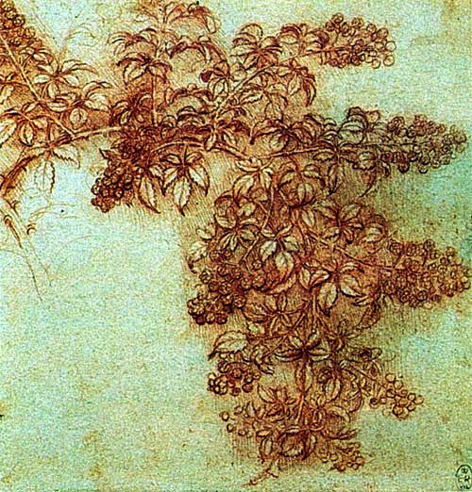

Slide 6
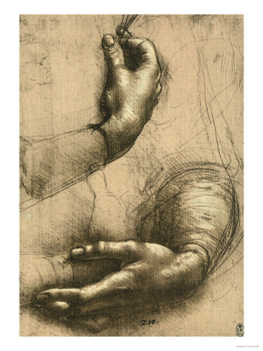
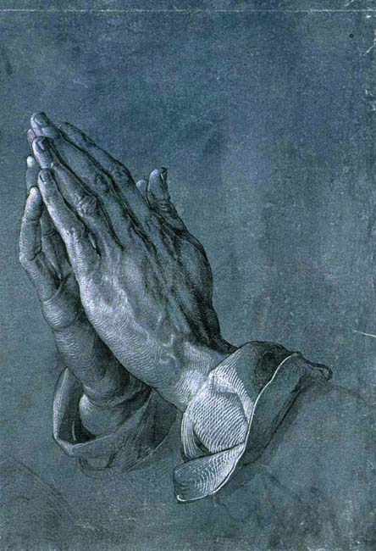

Slide 7
Your Assignment
To treat 2 pages with a soft wash using watercolor.
Become a Renaissance man/women for the next two weeks exploring anatomy, botany, and portraiture.
You may use text books, outside plants, skeletons, and observations of your hands, feet and portraiture.
Each page you design can have many different studies and themes.

